Slide 1


Week 8
1

Slide 2
Index
2
Sr no | index
1 | Piston head assemmbly
Sr. no
1
2
3
4
5
Contents
Week1Sketch1
Week1Sketch2 Week1Assignment1
Week1Assignment2 Insights

Slide 3
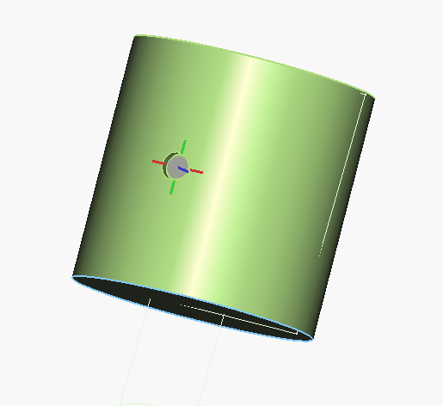
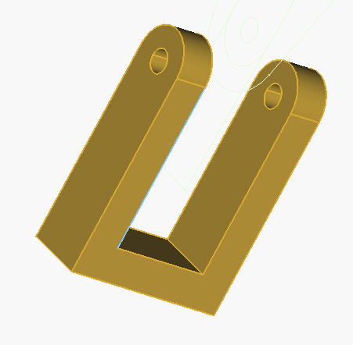
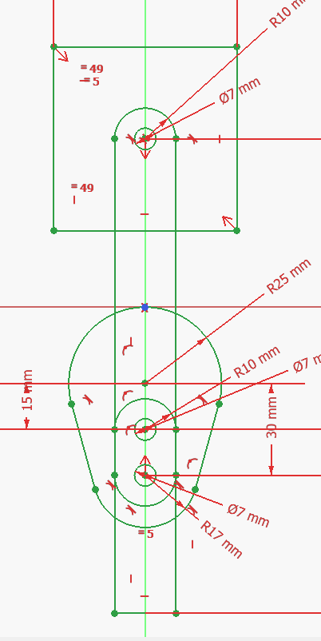
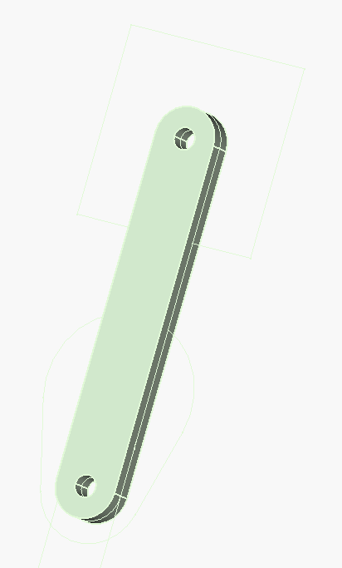
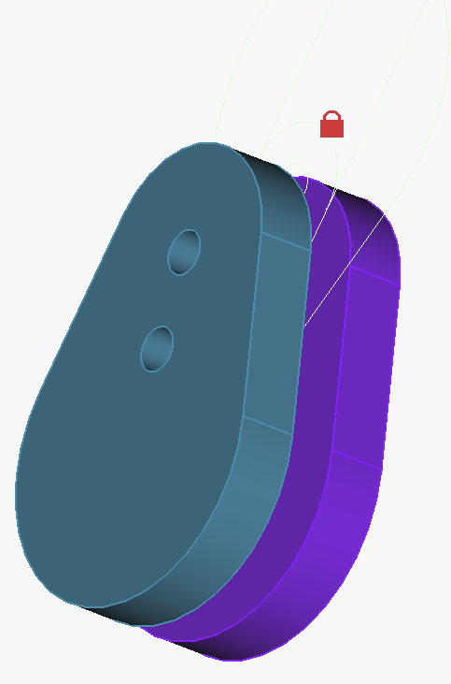
Different parts
Master Sketch

Slide 4
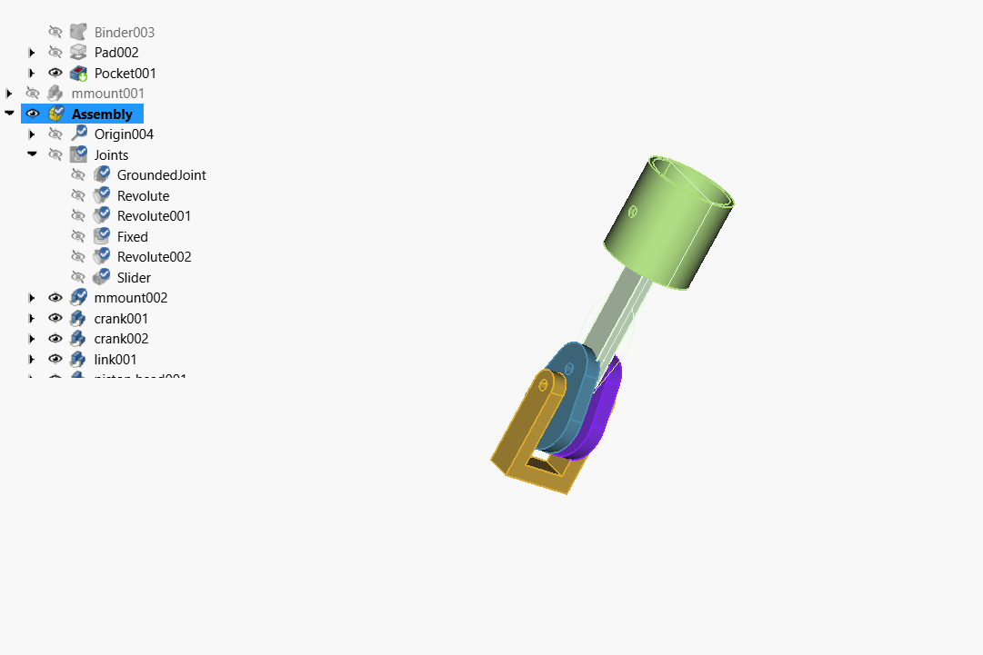
Finale Assembly

Slide 5
Insights
I learned how to create the entire assembly using a Binder Master Sketch in a single file.
I understood how a master sketch ensures better design coordination and consistency among all parts.It made the assembly more organized and reduced errors caused by mismatched dimensions.

